Slide 1
COMPILER DESIGN
(24CS2235F)
Grammar Fix: Dangling-Else Ambiguity Resolver
Team Members
Name: Vihas Vattikuti 2420030622
Name: Gade Harshavarshan Reddy 2420030456
Name: Ch Sai Nikhil Reddy 2420030085
Under the Esteemed Guidance of
K S NIRAJA

Slide 2
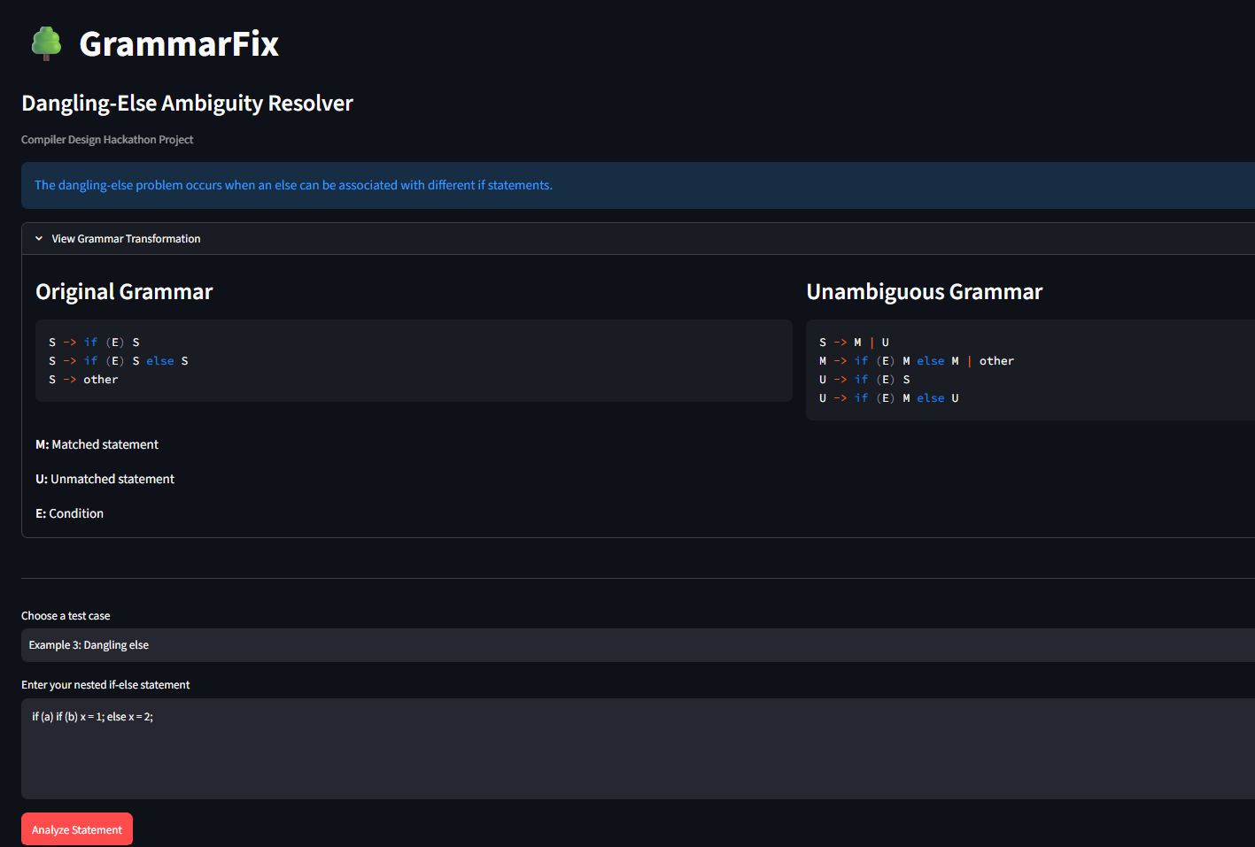
INTRODUCTION
GrammarFix is a web-based application developed to demonstrate and resolve the dangling-else ambiguity in compiler design.
The application accepts nested if-else statements, analyzes their structure, generates parse trees, and explains how grammar transformation removes ambiguity.
Key features:
Accepts if-else statements as input.
Converts source code into tokens.
Analyzes possible parse trees.
Identifies dangling-else ambiguity.
Demonstrates grammar transformation.
Provides automated test results.

Slide 3
Problem Statement
The dangling-else problem is a common ambiguity in compiler design. It occurs when an else statement can be associated with more than one unmatched if statement.
Consider the following code:
if (a)
if (b)
x = 1;
else
x = 2;
The question is: Which if statement does the else belong to?
There are two possible interpretations:
The else belongs to the inner if (b).
The else belongs to the outer if (a).
This ambiguity can produce multiple parse trees for the same input.
Visual: Show the nested if-else code and highlight the else statement.

Slide 4
Objectives
Understand the dangling-else ambiguity in programming languages.
Accept nested if-else statements through a web interface.
Tokenize and analyze the input statement.
Generate and visualize possible parse trees.
Demonstrate the difference between ambiguous and unambiguous grammar.
Apply grammar transformation to separate matched and unmatched statements.
Test the application using multiple test cases.
Expected outcome: Demonstrate how grammar transformation can remove dangling-else ambiguity.

Slide 5
Existing Grammar and Ambiguity
Explain that the original grammar permits both matched and unmatched if statements without explicitly separating them.
  S → if (E) S
  S → if (E) S else S
  S → other
Where:
  S = Statement
  E = Condition
  if = Conditional keyword
  else = Alternative branch
  other = Any non-if statement
The grammar allows the else to be associated with different if statements.
Therefore, some inputs can generate multiple valid parse trees.
Visual: Include your application's two original parse trees for the dangling-else example.

Slide 6
Proposed Solution
Explain that Grammar Fix demonstrates an unambiguous grammar by separating statements into two categories:
Matched statement (M): An if-else statement in which every if has a corresponding else, or a non-if statement.
Unmatched statement (U): A statement containing an unmatched if.
Use these grammar productions:
S → M | U
M → if (E) M else M | other
U → if (E) S
U → if (E) M else U
How it helps:
Separates matched and unmatched statements.
Defines how else is associated with nested conditions.
Removes the ambiguity represented by the original grammar.
Produces a single valid interpretation for the example input.
Visual: Show the original grammar on the left and the transformed grammar on the right.

Slide 7
System Architecture
Work Flow
User Input
↓
Streamlit Interface
↓
Tokenization
↓
Statement Parser
↓
Ambiguity Analysis
↓
Parse Tree Generation
↓
Graphviz Rendering
↓
Results Display
Component | Purpose
Streamlit | Provides the web interface.
Tokenizer | Splits the input into tokens.
Parser | Analyzes the statement's structure.
Ambiguity analysis | Checks possible interpretations.
Parse tree generation | Represents the statement's structure.
Graphviz | Visualizes the parse trees.
Automated tests | Checks expected and actual results.

Slide 8
Technology Used
Technology | Purpose
Python | Implements the application's logic.
Streamlit | Creates the interactive web application.
Graphviz | Generates parse-tree visualizations.
VS Code | Used to develop and execute the project.
Python provides a straightforward way to implement parsing logic.
Streamlit allows users to interact with the application through a browser.
Graphviz makes tree structures easier to understand visually.
VS Code provides an environment for writing and executing the code.

Slide 9
Implementation
Step 1: Input
The user enters an if-else statement or selects a predefined test case.
Step 2: Tokenization
The application identifies tokens such as if, else, parentheses, variables, operators, and statements.
Example:
  if (a)
  x = 1;
  else
  x = 2;
  Token stream:
  if ( a ) x = 1 ; else x = 2 ;

Slide 10
Implementation
Step 3: Parsing
The application analyzes the structure of the input statement.
Step 4: Parse Tree Generation
The application creates a tree representing the relationships between conditions and branches.
Step 5: Ambiguity Detection
The application checks how many valid parse trees are generated for the input.
Step 6: Grammar Transformation
The application demonstrates the transformed grammar and its intended role in removing ambiguity.
Step 7: Output
The user sees the tokens, parse trees, ambiguity information, and test results.

Slide 11
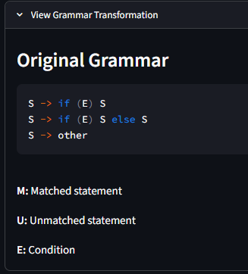
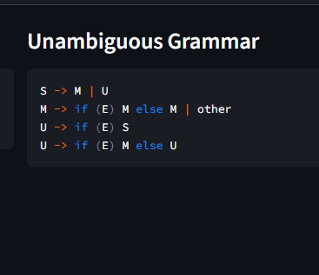
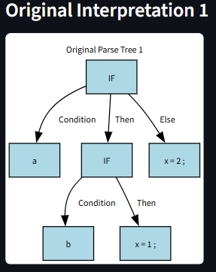
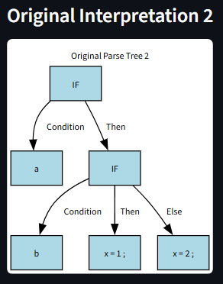
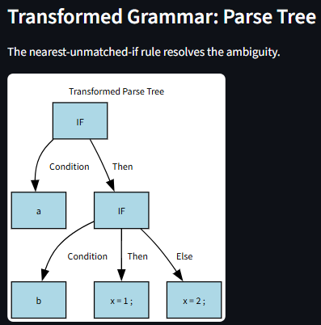
Results and Demonstation
The original grammar can produce multiple interpretations for the dangling-else example. The transformed grammar separates matched and unmatched statements to demonstrate how the ambiguity can be eliminated.

Slide 12
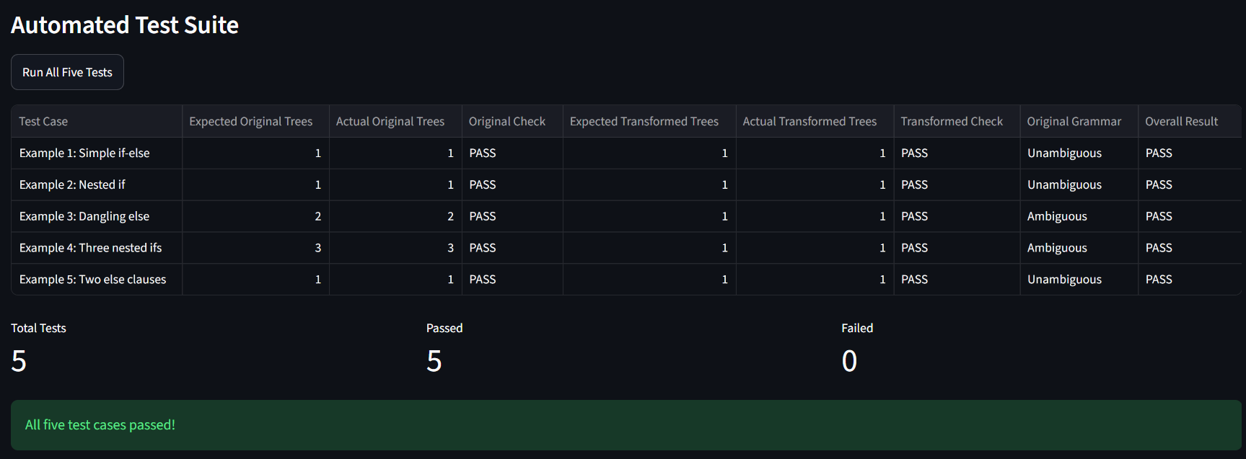
Automated Testing
All five predefined test cases passed according to the application's displayed results

Slide 13
Conclusion and Future scope
Conclusion
Grammar Fix demonstrates the dangling-else ambiguity in compiler design using nested if-else statements and parse-tree visualizations.
The application shows how the original grammar can produce multiple interpretations and how separating matched and unmatched statements can remove this ambiguity.
The project combines compiler-design concepts with an interactive web interface to make grammar analysis easier to understand.
Future Scope
Support more complex nested conditional statements.
Improve syntax-error detection and reporting.
Support additional grammar types and ambiguity examples.
Add step-by-step parsing explanations.
Extend the application to demonstrate other compiler-design concepts.

Slide 14
Thankyou

